Slide 1
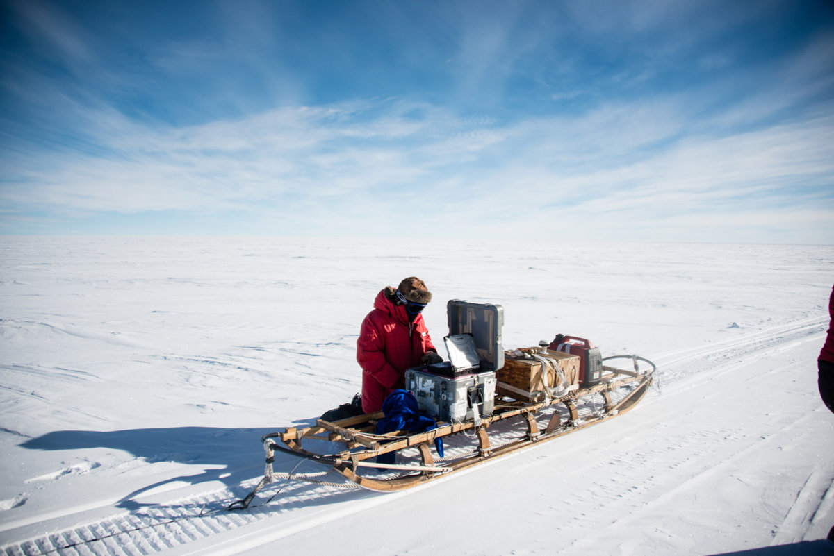
ImpDAR Tutorial
David Lilien
with Ben Hills, Joshua Driscol, Bob Jacobel, and Knut Christianson
U. Maine
November 22nd, 2021

Slide 2
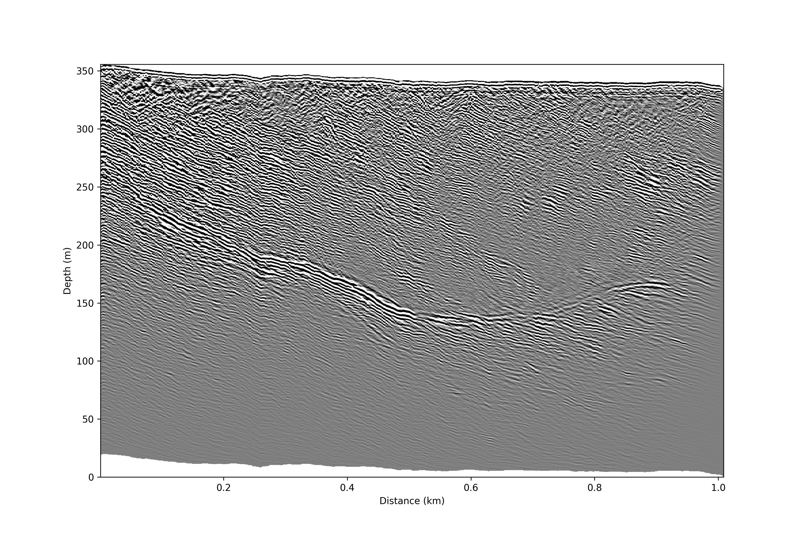
Radar Processing
Converting raw, binary radar output to a usable (and useful) form:
Load data into usable array
Process to reduce noise, convert to useful coordinates, etc.
Interpret (pick layers/features)
Plot (echograms, geographically, etc.)

Slide 3
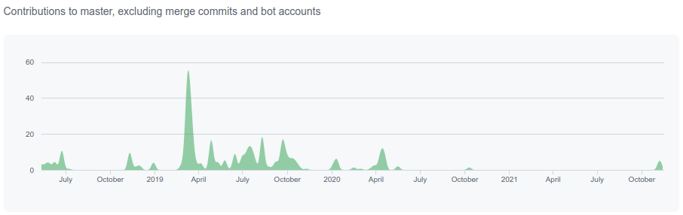
ImpDAR
Fully open source impulse radar processor
Unites processing chain for different systems
Can be used for loading, processing, interpreting, and plotting
Developed at U. Washington, based on (standard) codes from St. Olaf

Slide 4



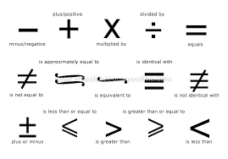
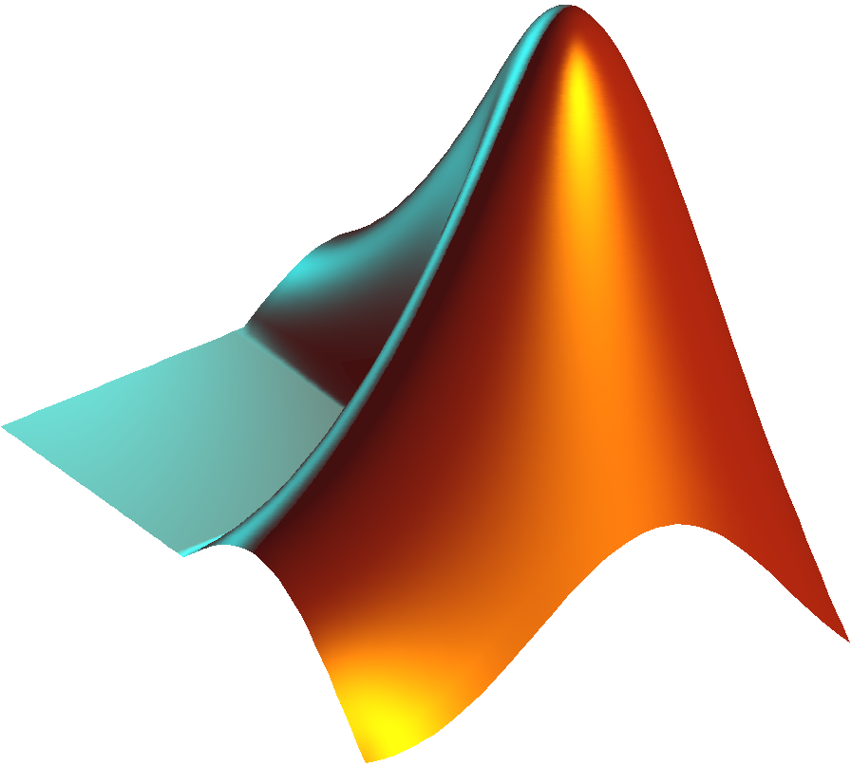
Problems ImpDAR solves
Proprietary (expensive) radar software
Lack of transparency in operations
Lack of reproducibility
Missing operations in alternatives
Matlab alternatives require updates/relicensing

Slide 5
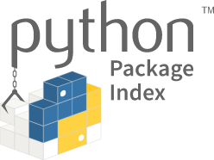
Installing ImpDAR
Requirements are mostly conda/pip installable
SeisUnix is very useful, we can talk about installation later if there is interest
ImpDAR itself installable with pip (including some accelerated migration routines) or directly from Github (for bleeding edge)

Slide 6
Interacting with ImpDAR: Load+process
Command Line
Very quick for batches
Intermediate output saved to look at
Cannot access every single option
Can fail for complex use cases
API (programmatic)
More control over steps
Less need to save intermediate output
Less quick for one-offs

Slide 7
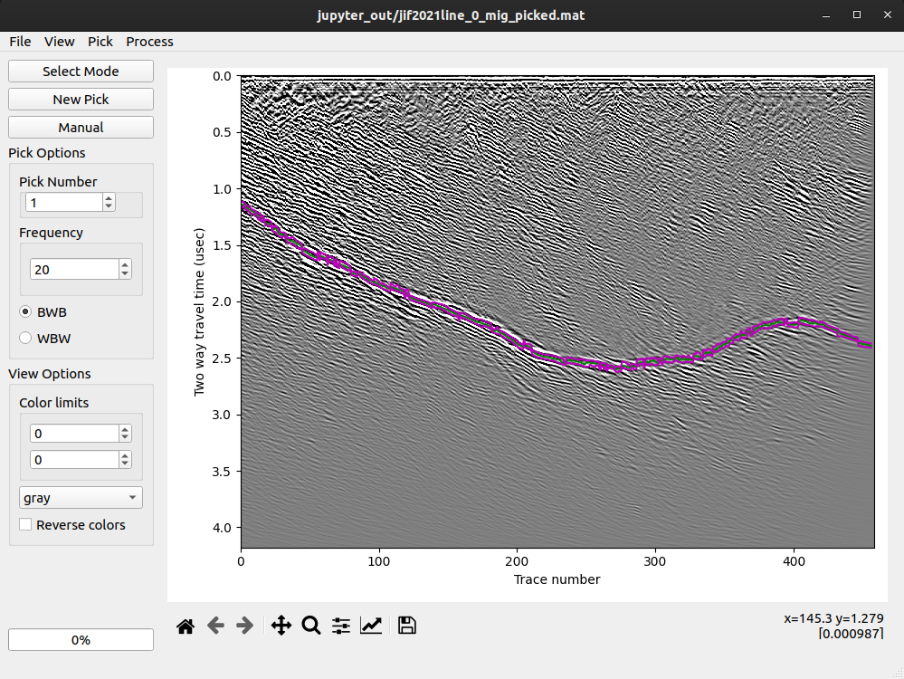
Interacting with ImpDAR: Interpretation
Requires PyQt5 (and thus Qt5)
Always called from the command line, handled in GUI
I am not an expert in making GUIs—you may find bugs!

Slide 8
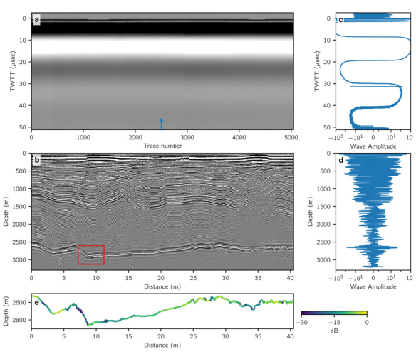
Interacting with ImpDAR: Plotting
Command Line
Very quick for batches
Only very basic customization
API (programmatic)
Can mix ImpDAR plots with anything else from matplotlib
Can create publication-quality figures (have been included in at least 3 papers so far)
May be unnecessarily complex for other uses

Slide 9
Getting help
impdar.readthedocs.io
Check the documentation yourself first, then either
github.com/dlilien/impdar/issues
Raise an issue via github or
david.lilien@umanitoba.ca
Email me for help

